Slide 1
Marketing
M A Rahman

Slide 2
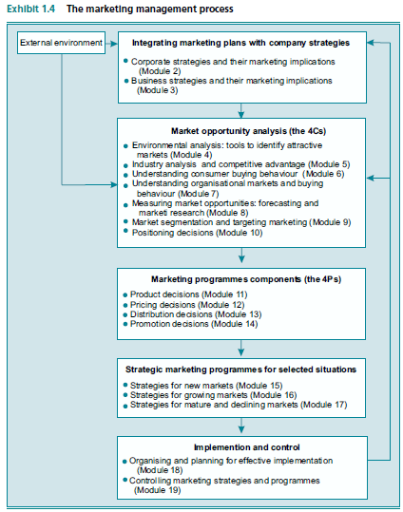

Slide 3
Part I: An Overview of Marketing Management
Process
Business
Corporate

Slide 4
1. The Marketing Management Process Contents
Problem
911 Gifts target only last-minute holidays shopper → revenue issues → New CMO to be CEO later
New Mission
She sold 1/3 for $30M, and hired new management team
Target Market
Qualitative marketing research for the above $80,000 annual income customers, eventually on past experience they defined the preferred goods
Target wider segments of customer, not only last-minute gift shoppers
New Products
Rename
Dist.
New products, new vendors to satisfy the needs of the potential upscale customers
High gross margin goods (dropped ½ of 450 and added 300 more)
Red Envelope, to reflect the upscale
Ads & Promos
Results
1/3 of the budget spent in ads in magazines few weeks before holidays
Partnership with e-shopping companies
Owned inventory, marketing, customer care but no physical logistics
Contracted with near airport company to have workers and warehouses
Instantaneous updates to have the right goods in stock
Huge success, lowering marketing costs with the increased RedEnvelope awareness
Decision Rationale
Relationships Value
Practice
Responsibility Matrix
New Tools

Slide 5
1.1 Why Are Marketing Decisions important?
Marketing attempts to measure and anticipate the needs and wants of a group of customers and respond with a flow of need-satisfying goods and services.
Target Customers
Develop Products
Make them available
Create Awareness
Get feedback
Build long-term relationship

Slide 6
1.1.1 The Importance of the Top Line
Top Line
Revenue
Customer Focus to provide really needed goods and services
Bottom Line
Enjoy Profitability

Slide 7
1.2 Marketing Creates Value by Facilitating Exchange Relationships
Marketing is a social process involving the activities necessary to enable individuals and organisations to obtain what they need and want through exchanges with others and to develop ongoing exchange relationships.
More specialisation
Relationships
Exchanges
Better Life style

Slide 8
1.2.1 What Factors Are Necessary for a Successful Exchange Relationship?
Identify Partners
Develop Offerings
Communicate Information
Deliver Products
Collect Payments
Exchange Tasks
Who are the parties?
Which needs and wants?
What is exchanged?
How does exchange create value?
How does exchange make a market?

Slide 9
1.2.2 Who Markets and Who Buys? The Parties in an Exchange
Marketers
Profit
Goods
BMW, Zara, Wall Mart … etc.
Services
McDonalds, Air France … etc.
Non Profit
Museums, universities … etc.

Slide 10
1.2.2.1 Customers
Customers
Ultimate Customers
End Users
Organisations Customers
Resale
Production material
Day to day operation

Slide 11
1.2.3 Customer Needs and Wants
Current status
Physical, Emotional
Need
Desired Status
Physical, Emotional
Want
Preferences of satisfying a basic need
Impossible
Marketers create needs
Possible
Marketers make people want things they don’t need

Slide 12


1.2.3.1 Do Customers Always Know What They Want?
What about organisational customers who buy most of the goods and know technology
Customer Focus
Low Marketing Efforts
R & D
Unleash creativity, or else you will just make marginal improvement on one product line

Slide 13
1.2.4 What Gets Exchanged? Goods and Services
Products
Goods
Tangible, physically acquired
Services
Less tangible, doesn’t end with ownership

Slide 14
1.2.5 How Exchanges Create Value
Buy
Best benefit satisfying products
After sale
No bad surprise
Loyalty
Loyalty maintains profits
Good complaints handling
It is always easier to keep existing customers than to get new ones

Slide 15
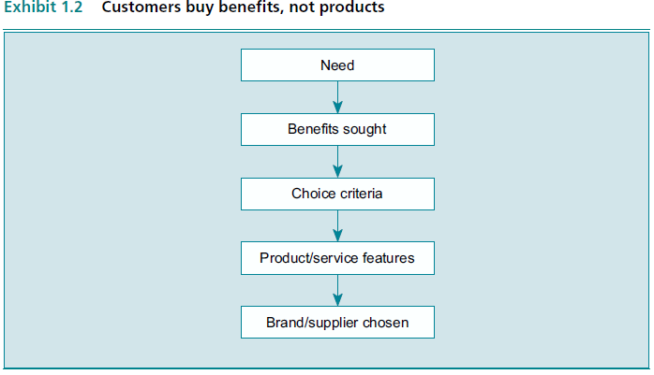
1.2.5.1 Customers Buy Benefits, Not Products
Because different customers seek different benefits, they use different choice criteria and attach different importance to product features when choosing models and brands within a product category
Might be self esteem or simple transportation mean
Most need-satisfying benefits per dollar

Slide 16
1.2.5.2 Product Benefits, Service, and Price Determine Value
Before
Best need satisfying benefit per dollar
After
If benefits were up to expectations
Customer satisfaction
Handle complaints

Slide 17
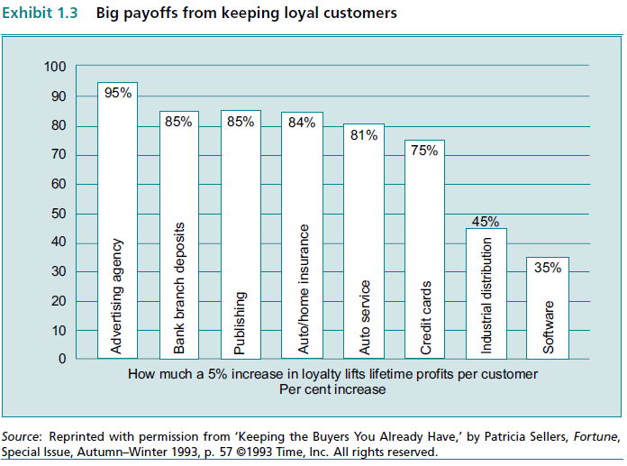
1.2.5.3 The Value of Long-Term Customer Relationships
It costs more attracting a new customer than keep an existing one, as you have to lower prices or utilise extensive and costly communication methods

Slide 18
1.2.6 Defining A Market
What are the current needs my product can offer
How each segment prefer it
OK now, which segment I will target
I will work on effective distribution
Market
Buyer
Want (needs and wants) and able to buy (sufficient resources)
Segment
I want Mercedes
Segment
Fiat is OK
Seller
Goods and services providers
Brands

Slide 19
1.3 What Does Effective Marketing Practice Look Like?
Strategic Marketing Program
Analyses
Decisions
Activities
Planning
Implementation
Evaluating

Slide 20
1.3.1 Marketing Management – A Definition
Analysing
Planning
Implementing
Coordinating
Controlling
Conception
Pricing
Promotion
Distribution

Slide 21
1.3.1.1 A Decision-Making Focus
Decisions:
What to do
When and How

Slide 22
1.3.1.2 Analysing the 4Cs
Company
Context
Customers
Competitors

Slide 23
1.3.2 Integrating Marketing Plans with the Company’s Strategies and Resources
Corporate Strategy
Company’s mission, allocating resources
BU Strategy
How to compete in a selected business
Marketing strategy
How to market a product
Module 2 & 3

Slide 24
1.3.3 Market Opportunity Analysis
Plan
Macro-environmental analysis (Module 4)
Industry Analysis (Module 5)
Customer Analysis (Module 6 for individual, Module 7 for ogrs)
Tools
Marketing Research techniques (Module 8)
Start
Segmentation (Module 9)
Positioning (Module 10)

Slide 25
1.3.3.1 Environmental Analysis
Environmental Analysis
Demographic
Economic
Technological
Social
Module 4

Slide 26
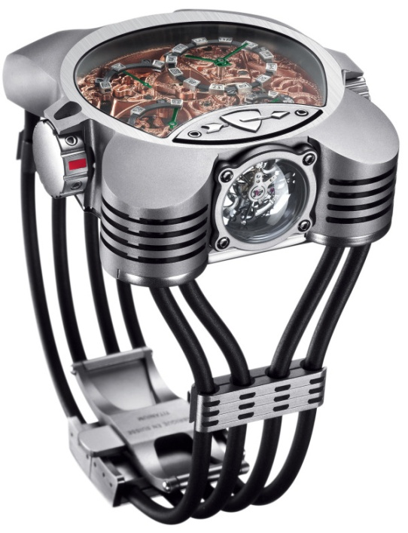
1.3.3.2 Industry Analysis and Competitive Advantage
The competitive and market environments of an industry are not static
Module 5

Slide 27
1.3.3.3 Customer Analysis
What are the needs and wants?
How they affect product features?
Where they shop?
How they will react to promotions?
Module 6 for people
Module 7 for orgs

Slide 28
1.3.3.4 Marketing Research and Market Information
Satisfaction and loyalty of current customers
Firm’s wholesale and retail partners
Strengths and weaknesses of competitors
Module 8

Slide 29
1.3.3.5 Market Segmentation, Targeting, and Positioning Decisions
Market segments
Distinct subsets of people with similar needs, circumstances, and characteristics that lead them to respond in a similar way to a particular product or service offering
Position the product or service offering
Design the product and its marketing programme so as to emphasise attributes and benefits that appeal to customers in the target segment
Module 9: Defining and selecting market segments
Module 10: Positioning

Slide 30
1.3.4 Formulating Strategic Marketing Programs
Product
Price
Promotion
Place (Distribution)

Slide 31
1.3.4.1 Marketing Programme Components
4Ps
Product
Price
Promotion
Place
Module 11 till 14

Slide 32
1.3.5 Formulating Strategic Marketing Programs for Specific Situations
New Goods
Module 15
Growing Markets
Module 16
Mature and Declining Markets
Module 17

Slide 33
1.3.6 Implementation and Control of the Marketing Programme
Strategy
On-ground Capacity
Module 18: Implementation
Module 19: Evaluation and Control

Slide 34
1.3.7 The Marketing Plan – A Blueprint for Action
Current Situation
Summary, 4Cs, Performance & SWOT
Adopted Strategy
Objectives and Marketing strategy
Action Plan
Target market, 4Ps Actions, who, when and how much
Controls, Projected profits and loss statement
Contingency Plans
When certain threat happens

Slide 35
1.4 Who Does What?
Distribution
Merchant Wholesaler
Take the title
Agent middlemen
Brokers
Retailers
To end user
Facilitating Agencies
Like ads

Slide 36
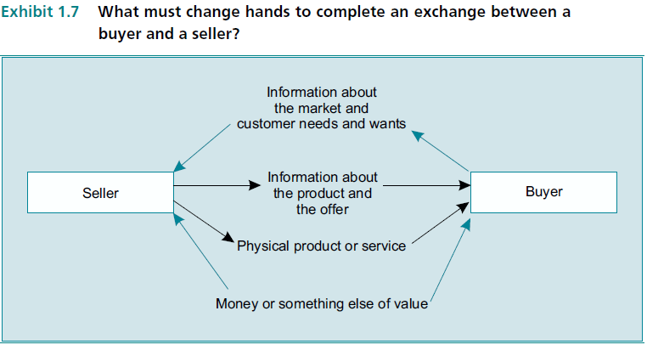
1.4.1 Marketing Institutions
When producer do it all (rare), it is Vertical Integration

Slide 37
1.4.2 Who Pays the Cost of Marketing Activities – and Are They Worth It?
100%
50%
Marketing & Distribution
Wholesalers and middlemen margin
50%
Producer Margin
Retailer Price
In Normal Cases
But more Efficient
Transactional Efficiency: Buy all goods from one place
Functional Efficiency: Cheaper for end user to have wholesaler get him the goods
Possession Utility: Minimum risk and shopping time
Place Utility: Where I want
Time Utility: When I want

Slide 38
1.4.3 Room for Improvement in Marketing Efficiency
Decreased Costs
Decreased Costs
Marketing Costs
Global competition, Fast tech. … etc.
Production Costs
Automation, process enhancement, JIT … etc.
Management Costs
Downsizing, multi-tasks, modern theories … etc.
1- WWW usage
2- Alliances
3- New budgeting

Slide 39
1.4.4 The Role of the Marketing Decision Maker
Formulate Marketing Plans is the main responsibility
Impossible to control all participants, or to have capacity to conduct all researches and gather info.
Alliance with distributors and subcontractors is the answer
Marketing should be everyone’s business

Slide 40
1.5 Some Recent Developments Affecting Marketing Management
Changes
Globalization & Competition
Growing Services sector
IT
Cooperation importance

Slide 41
1.5.1 Globalisation
Profit Chance
Challenging setup and fast strategy adaptation

Slide 42
1.5.2 Increased Importance of Service
66% of US economy is services
Service is any activity or benefit that one party can offer another that is essentially intangible and that does not result in the ownership of anything. Its production may or may not be tied to a physical product
Such as financing, delivery, installation, user training and assistance, and maintenance
Main focus: Ever-lower prices, the creative design and effective delivery of supplemental services

Slide 43
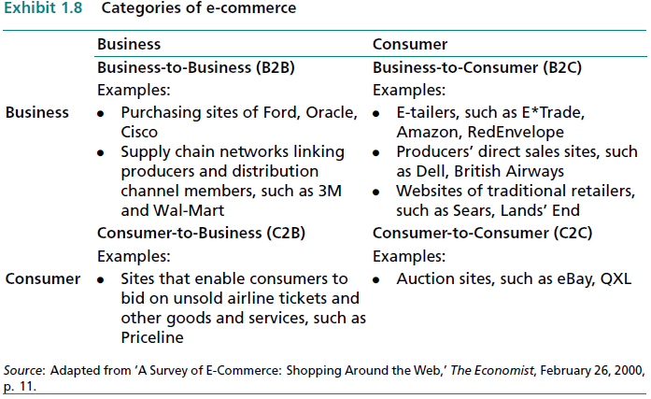
1.5.3 Information Technology
Analysis
Collect customer info
More segments
Connection
Easier to communicate
New Channels

Slide 44
1.5.4 Relationships across Functions and Firms
Develop and nurture long-term relationships and alliances
The boundaries between functional areas are beginning to blur

